Slide 1

Sellinger Applied Portfolio
Portfolio Review |Fall 2017

Slide 2

TABLE OF CONTENTS
Overview
Economic Conditions
Sector Summaries
Portfolio Strategy & Composition
  Growth
  Value
  Dividend
Risk Analysis
Performance Review
Student Biographies

Slide 3

overview
Fall 2017
Overview
Economic Conditions
Portfolio Strategy & Composition
Sector Summaries
Risk Analysis
Performance Review
Student Biographies

Slide 4
Sellinger Applied Portfolio Overview
Background
Process
The Student-Managed Sellinger Applied Portfolio Fund “SAP Fund” was established to provide students with actual portfolio management experience. Students are exposed to various aspects of the portfolio management process, including asset valuation, diversification, portfolio optimization, asset selection, risk management, performance evaluation, and rebalancing . Each year the University may provide the SAP Fund with up to $500,000 to invest. These funds are a component of the University’s endowment.
The faculty hand selects 20 eligible students to manage the Sellinger Applied Portfolio Fund each semester. Member participation stems from team formation to analyze and pitch stock recommendations for the fund to invest in. Members in their entirety then vote on wither the recommendations pass and are implemented into the fund.
Team Formation
Team Pitches
Current events
Stock analysis
Sector coverage assigned
Stock recommendations
Students vote on recommendations
Investment Voting

Slide 5
Sellinger Applied Portfolio Overview
Objective
Select stocks that are undervalued and will outperform their industry and the S&P 500 index over the course of the investment period.
Asset Allocation Targets
Not more than 10% invested in any one stock
Not more than 20% invested in any one sector
Not more than 25% invested in any one index
40% Value | 40% Growth | 20% Dividend
No “sin” stocks
Benchmark
S&P 500 Index

Slide 6
Economic Conditions
Fall 2017
Overview
Economic Conditions
Portfolio Strategy & Composition
Sector Summaries
Risk Analysis
Performance Review
Student Biographies

Slide 7
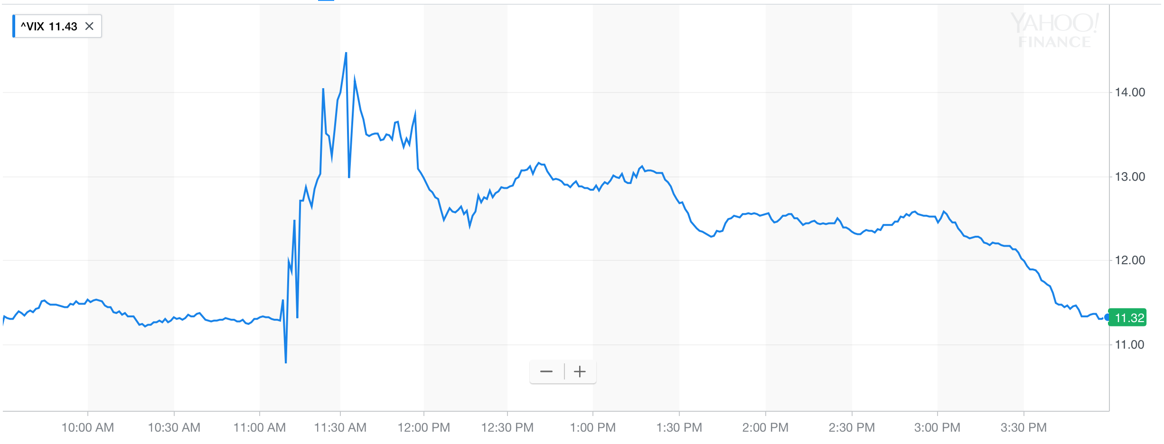
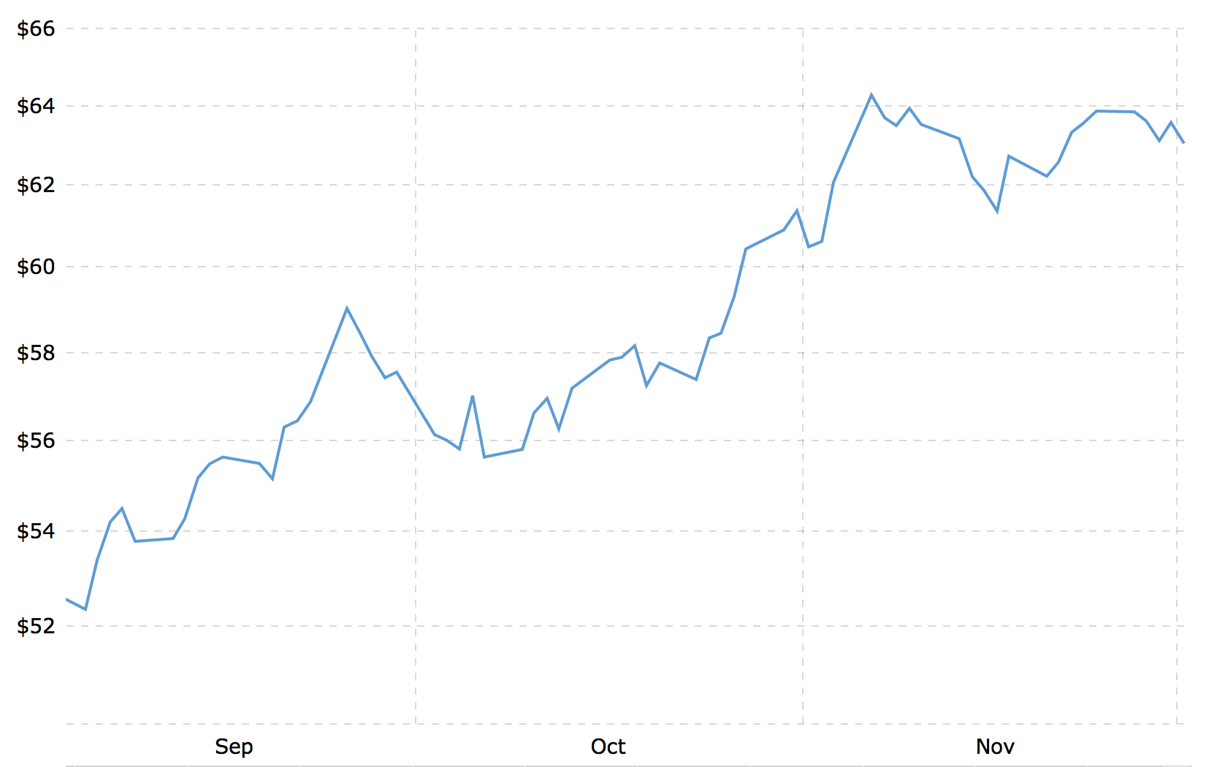
Market Overview
One rate hike left this year
  Will occur at the Fed’s December meeting
OPEC extended its agreement to limit output an additional nine months
  Price has risen over 30% since June
Chinese Yuan strengthens against the dollar
  Strengthened around 0.39% against the dollar
VIX: 11.32 (As of December 3rd, 2017)
Brent Crude Oil: $63.04 (As of December 3rd, 2017)
Source: Yahoo Finance
Source: MacroTrends

Slide 8
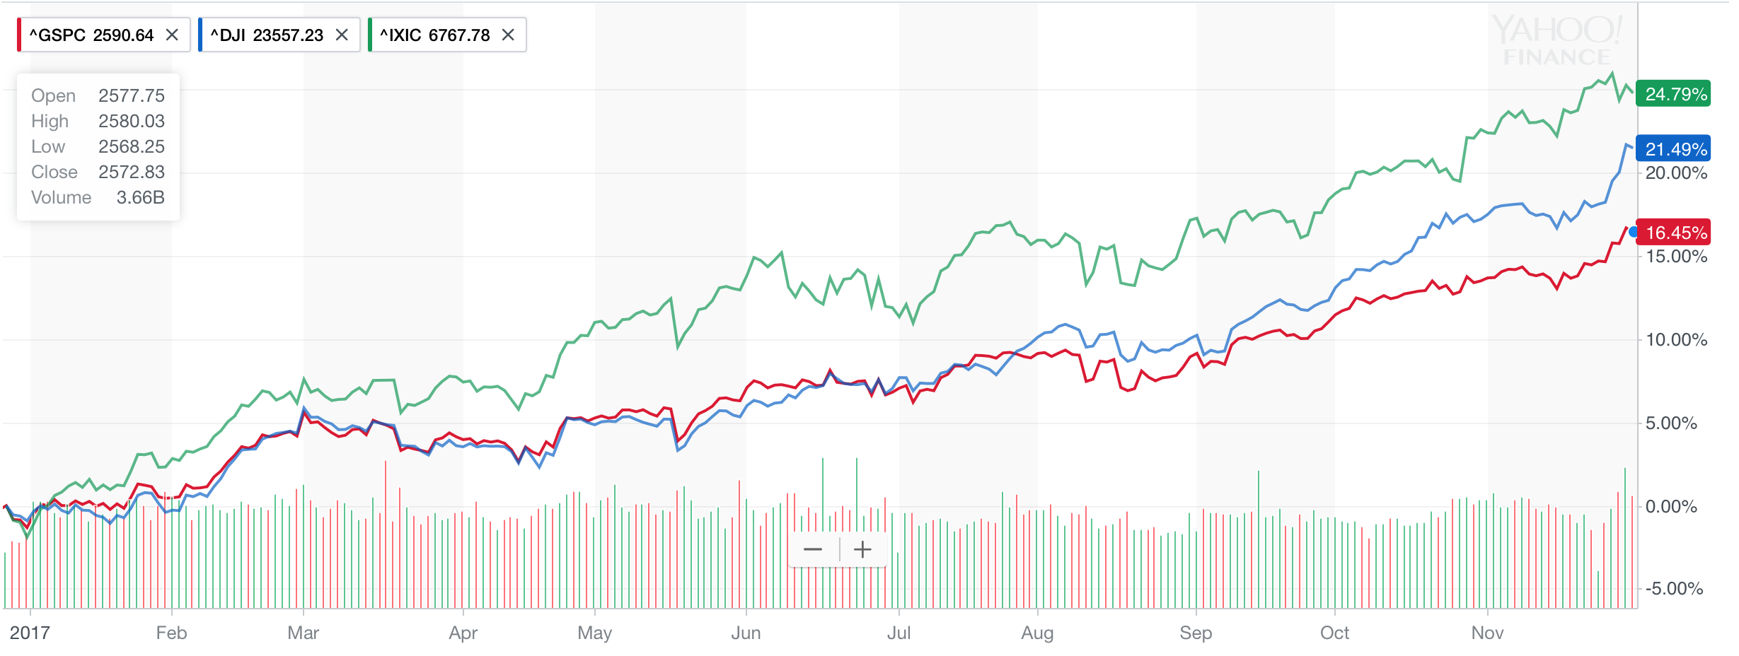
Major Indices Returns
Year to Date Return
S&P
+16.45%
DJI
+21.49%
NASDAQ
+24.79%
Source: Yahoo Finance

Slide 9
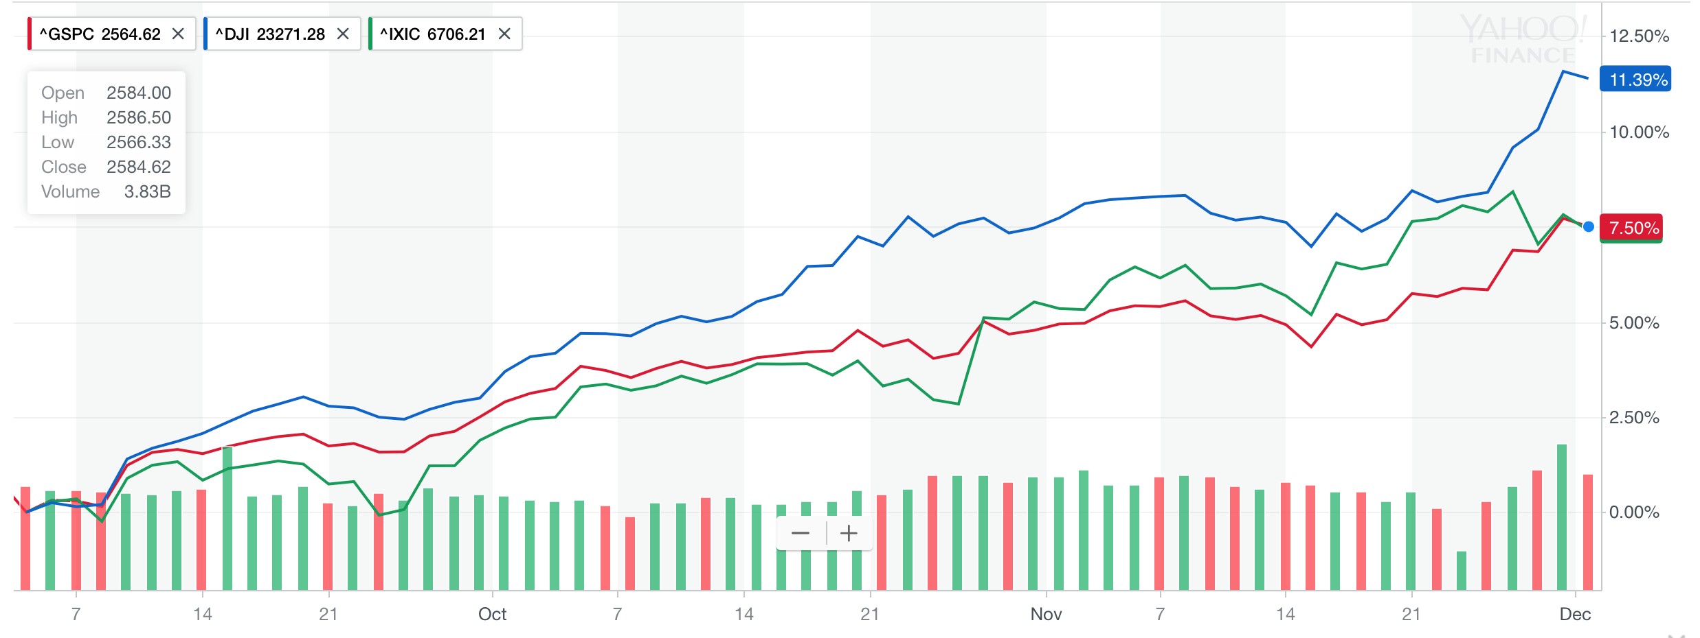
Major Indices Returns
3-Month Return
S&P
+7.5%
DJI
+11.39%
NASDAQ
+7.5%
Source: Yahoo Finance

Slide 10
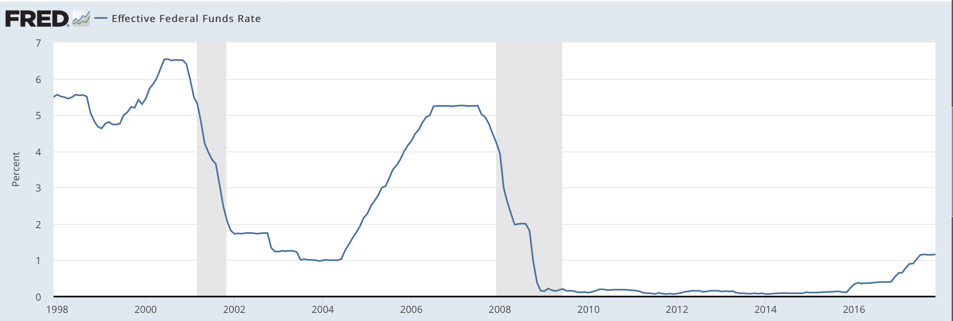
Federal Reserve Policy
Fed Policy Spring 2017
What Happens When Fed Rate Increases?
Current effective Federal Funds Rate: 1.16%
November: Jerome Powell elected new Federal Reserve Chair
Anticipated rate hike at next meeting
Increased cost of borrowing for businesses and individuals
Contractionary monetary policy
Slower GDP growth

Slide 11
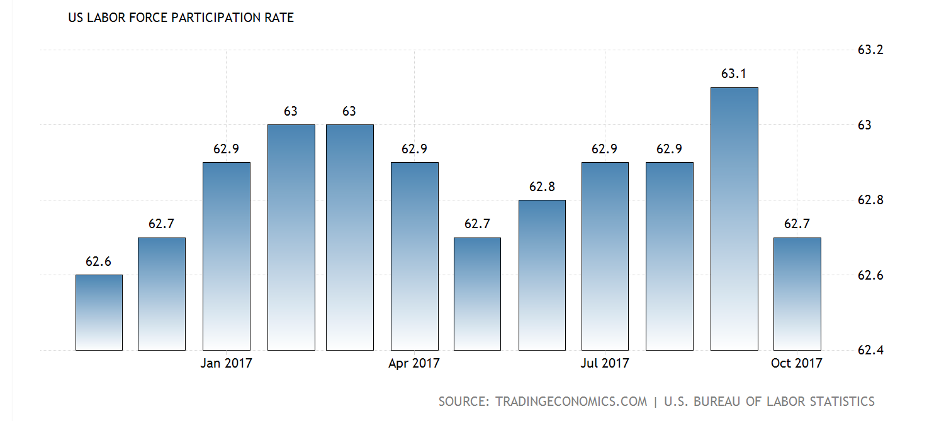
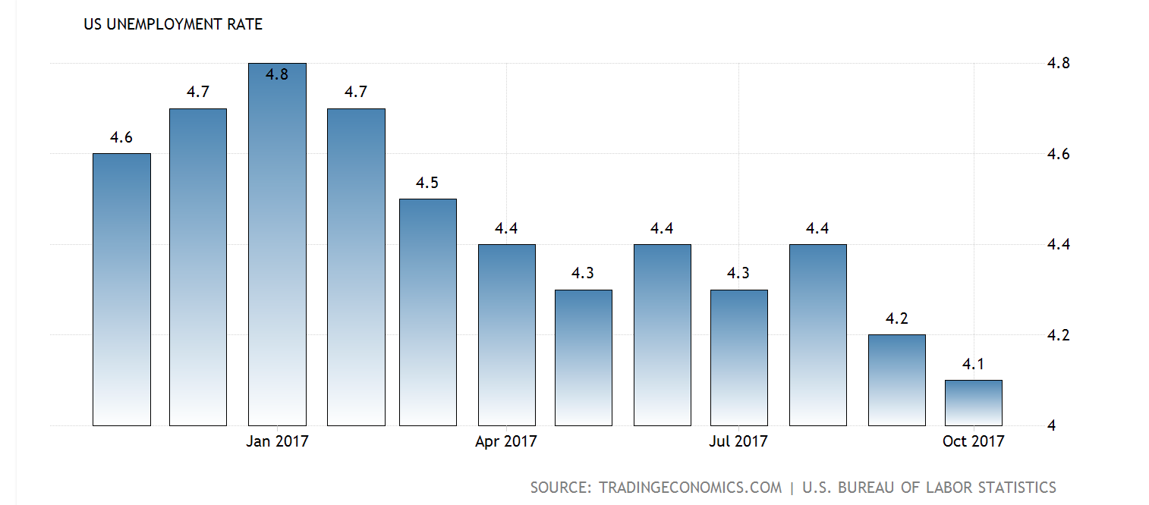
Employment
Unemployment rate as of October 2017: 4.1%. Below 5% benchmark
Total nonfarm payroll increased by 228,000 in November
Nonfarm Payroll Employment
Unemployment
Labor Force Participation Rate
Movement of employment by Sector
Growth in healthcare and financial services expected in the future. Job loss in energy and mining
Labor force participation rate: 62.8% currently

Slide 12
International News
China
China’s debt is growing at its fastest rate in four years. The debt in the real estate sector has multiplied over the last five years, as well as industrials.
China is fighting the EU for recognition as a market economy, a designation that would lead to dramatically lower anti-dumping duties on Chinese goods by prohibiting the use of third-country price comparisons. This recognition would weaken many countries' trade defenses against a flood of cheap Chinese goods, putting the viability of more western industries at risk.
North Korea
North Korea has continued to test nuclear missiles and recently confirmed that the latest rocket launch was a new type of intercontinental ballistic missile capable of reaching U.S. mainland.
The North Korean regime is believed to use a complex network of front companies to do business in China and other countries in order to dodge sanctions. In September, President Trump signed an executive order that would penalize any company or person doing business with North Korea by either cutting off their access to the U.S. financial system, freezing their assets, or both.
Europe
Central and southeastern European economies are on course for their strongest year of growth since the global financial crisis, in part due to a surge in wages and stronger demand from the recovering eurozone. The European Bank for Reconstruction and Development now expects Poland’s economy to grow by 4.1% in 2017, having projected an expansion of 3.2% in May. It now expects Romania’s economy to grow by 5.3% in 2017, having previously forecast an expansion of 4%.

Slide 13
Sector summaries
Fall 2017
Overview
Economic Conditions
Portfolio Strategy & Composition
Sector Summaries
Risk Analysis
Performance Review
Student Biographies

Slide 14
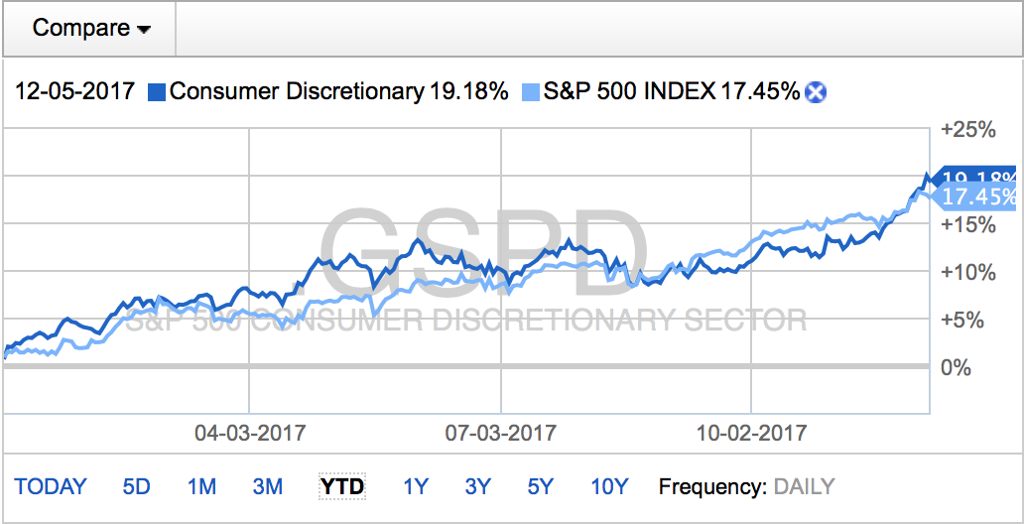
Consumer Discretionary
Performance (YTD):
19.18%
Portfolio:
Consumer Discretionary ETF (XLY)
Smucker JM Company (SJM)
Thor Industries, Inc. (THO)
Vail Resorts, Inc. (MTN)
Stocks to Watch:
Amazon (AMZN)
Shopify (SHOP)
The Consumer Discretionary sector of the economy is businesses that produce, and sell goods or services that are non-essential. Companies this sector can include traditional retailers, media, automobile, and component companies. Generally speaking, in a bull economy, companies in this industry will perform well. In a bear market, these stocks will underperform other segments as consumers have less disposable income.
-Growing economy
-Increased consumer spending
-Improving job market
-Hurricane damage spending
-Slowing economy
-Falling wages
-Negative growth
-Trend of declining retail sales

Slide 15
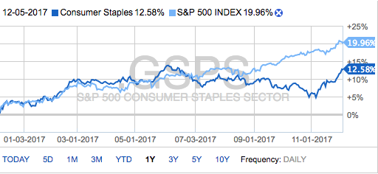
Consumer Staples
Performance (YTD):
12.58%
Portfolio:
Consumer Stapes ETF (XLP)
Procter & Gamble (PG)
Wal-Mart Stores Inc. (WMT)
Stocks to Watch:
Kroger (KO)
Johnson & Johnson (JNJ)
Nestle (NSRGY)
The Consumer Staples Sector comprises companies whose businesses are less sensitive to economic cycles. Any product considered a consumer staple is something that is essential or necessary for basic living. The top industry in the sector is beverages, which is then followed be cosmetics, agriculture, food, retail, household products, and sovereign.
-A safe haven during periods of market volatility or economic downturn
-Aggressive cost cutting
-Increase in mergers and acquisitions
-Possible increase in an accommodative monetary policy
-Evolving preferences
-Increased competition

Slide 16
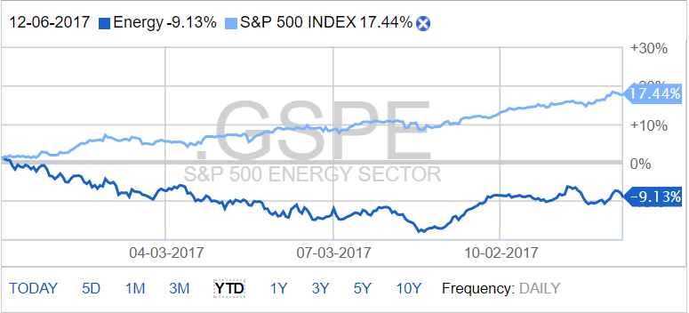
Energy
Performance (YTD):
13.78%
Portfolio:
None
Stocks to Watch:
Anadarko Petroleum (APC)
Tesla (TSLA)
Exxon Mobil (XOM)
EOG Resources (EOG)
The Energy Sector includes companies that develop or explore oil or gas reserves, oil and gas drilling, or power firms. Supply and demand for worldwide energy drives the performance in this sector. When oil and gas prices are high, energy producers perform very well. This sector is very sensitive to the political climate and news releases. Although the S&P 500 is up more than 12% this year, the S&P 500 Energy sector is down more than 9% for the year.
-Trump is favorable for the natural gas industries
-War can drive up energy prices
-Weather and natural disasters
-Currency and pollical forces

Slide 17
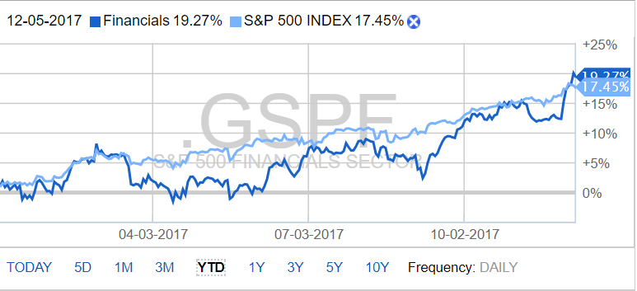
Financials
Performance (YTD):
12.58%
Portfolio:
Financial Sector ETF (XLF)
BOFI Holding Inc. (BOI)
Stocks to Watch:
Bank of America (BAC)
Citigroup (C)
JP Morgan (JPM)
Wells Fargo & Co (WFC)
The Financials Sector contains firms that supply various differing financial services to both retail and commercial consumers. These firms include insurance companies, investment funds, banks, money management firms, and real estate. Currently, the largest industry in the financials sector is banks, followed by insurance companies. The rest of the industries are categorized as diversified financials. The overall health of the economy is also strongly linked to the health of the financials sector. When the economy does well, usually so does financials. As we continue to go through a rising interest rate environment, financials stand to benefit.
-Grows with the rest of the economy
-Less risky due to reforms enacted since 2008
-Subject to economic cycles

Slide 18
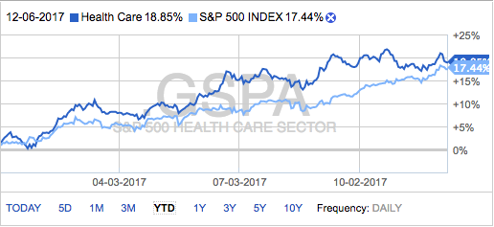
Healthcare
Performance (YTD):
18.85%
Portfolio:
Healthcare ETF (XLV)
Pfizer, Inc. (PFE)
Becton Dickinson & Company (BDX)
Stocks to Watch:
Aetna Inc. (AET)
Johnson & Johnson (JNJ)
Regeneron Pharmaceuticals, Inc. (REGN)
The Healthcare sector consists of companies dealing with products related to health care as well as research and development. Industries classified under this sector include: Biotech, Pharmaceuticals, and various health care providers, tech and equipment providers.
-International Growth
-Personalized Medication
-Advances in IT
-Opioid Crisis
-Uncertainty with healthcare reform

Slide 19
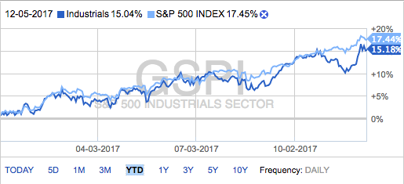
Industrials
Performance (YTD):
15.04%
Portfolio:
Industrials ETF (XLI)
Stanley Black & Decker (SWK)
USG Corporation (USG)
Honeywell International, Inc. (HON)
Stocks to Watch:
General Electric Co. (GE)
3M Co. (MMM)
Emerson Electric Co. (EMR)
The Industrials sector is quite extensive and covers areas from Aerospace and defense to the engineering of products and providing of services. The industries found within the sector consist of: Airline, Machinery, Road & Rail, Construction, Equipment and various services.
-GOP Tax Reform
-AI/Tech Advances
-Lower Oil Cost
-NAFTA Uncertainty
-International Competition
-Environmental Awareness

Slide 20
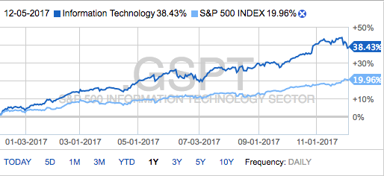
Information Technology
Performance (YTD):
38.42%
Portfolio:
Technology ETF (XLK)
Facebook (FB)
Cognizant Tech (CTSH)
Stamps.com, Inc. (STMP)
Lam Research Corp. (LRCX)
Softbank Group ADR (SFTBY)
Stocks to Watch:
Microsoft Inc. (MSFT)
Apple Inc. (AAPL)
The Information Technology Sector is made up of sixty-nine companies that are engaged in developing and manufacturing semiconductors, communications equipment, computer hardware and technology-related office equipment, and providing consulting and IT services.
-Artificial intelligence and cloud computing
-A demand IT security by large companies to protect customer information
-Outperformed the S&P since 2009
-Recent government intervention in IT
-Possible Russian-linked social media accounts

Slide 21
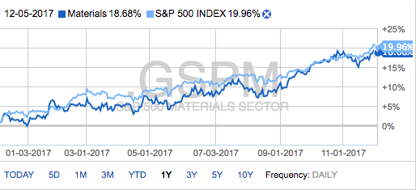
Materials
Performance (YTD):
18.68%
Portfolio:
Materials ETF (XLB)
DowDuPont, Inc. (DWDP)
Stocks to Watch:
Masco Corp. (MAS)
CVR Partners (UAN)
The Materials sector of the market encompasses a wide range of commodity-related manufacturing industries. This sector includes companies engaged in chemicals, construction materials, packaging products, metals and mining, paper products, and materials sector ETFs.
-Devastation from the 2017 hurricane season
-Increase in mergers and acquisitions
-Low unemployment
-Low commodity prices
-Chinese demand might be slowing down
-Impacted by cyclical demand and volatility in raw material and energy prices

Slide 22
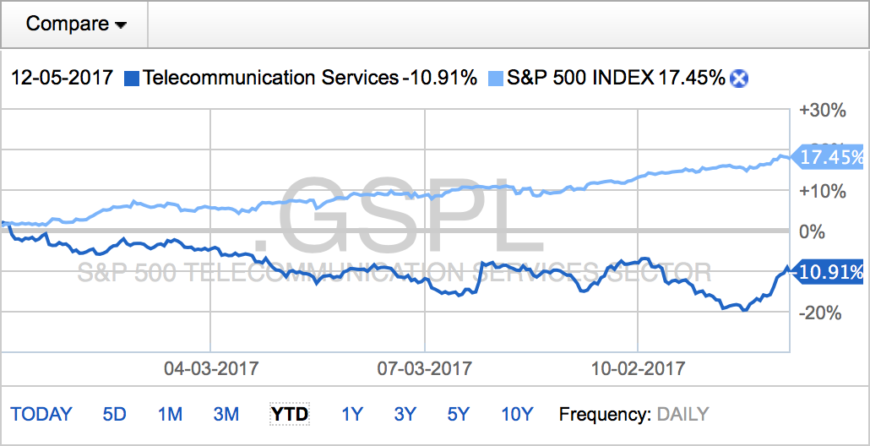
Telecommunications Services
The Telecommunications sector, or telecom, consists of companies that provide communications services primarily through fixed-line, cellular, wireless, high bandwidth, and/or fiber-optic cable networks. The sector can be split into three sub-industries; integrated or diversified telecommunication services, alternative carriers, and wireless telecommunication services.
Performance (YTD):
-10.91%
Portfolio:
Vanguard Telecomm ETF (VOX)
Comcast Corporation (CMCSA)
Stocks to Watch:
AT&T (T)
Verizon Communications, Inc. (VZ)
-Increased demand for smartphones
-Large firms are looking to expand and acquire smaller companies
-”Cord-cutting”
-Increased competition from communications and media companies in the consumer discretionary index

Slide 23
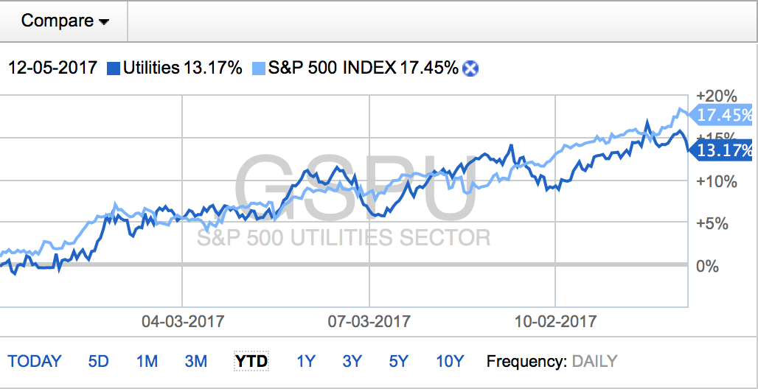
Utilities
Performance (YTD):
13.70%
Portfolio:
Utilities ETF (XLU)
Stocks to Watch:
NextEra Energy (NEE)
Atlantic Yield Plc (ABY)
The Utilities Sector is comprised of four distinct industries: gas, water, and electric firms, as well as independent companies that produce or distribute power. Utilities falls under the defensive super sector. In order to provide this huge amount of power to large amounts of homes and businesses, utility companies need to undertake a serious amount of infrastructure, and to do that must hold a lot of debt.
-Very sensitive to changes in interest rates
-Large debt-equity ratios
-Hurricane season had a strong negative impact
-Low beta, risk averse
-New legislation from Trump administration

Slide 24
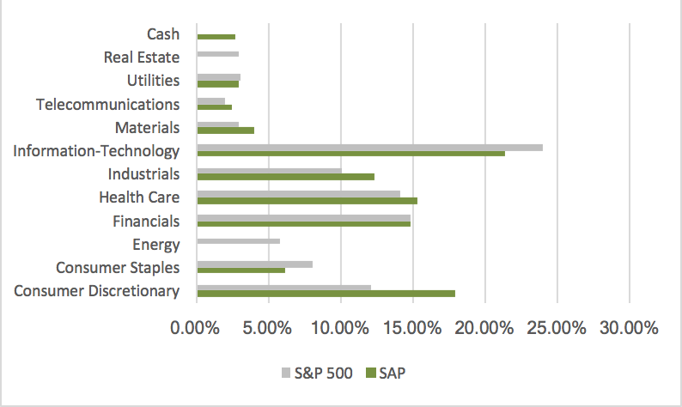
Sector Allocation
SAP vs. S&P 500
As of December 5, 2017

Slide 25

Portfolio strategy & composition
Fall 2017
Overview
Economic Conditions
Portfolio Strategy & Composition
Sector Summaries
Risk Analysis
Performance Review
Student Biographies

Slide 26
Growth Strategy Overview
To find stocks expected to grow faster than their industry peers
BUY CRITERIA
Conservative Mentality | Expect stock to perform better than the Industry
Revenue Growth | Industry Average and forecasted to continue to grow
Strong Earnings | 5 years of CAGR
ROE | ≥ 15% and > Industry Average
PEG | ≤ 1.2 and < Industry Average
Debt/Equity | < 1.5 (or Acceptable Interest Coverage Ratio when D/E >1.0)
SELL CRITERIA
Price | Price reaches 10% below target price or 20% above purchase price
Leadership | The company’s leadership position changes
Business Fundamentals | Business fundamentals deteriorate
Company slowdown | Slowing unit volume, revenue decline, weak earnings, etc.
Alternative Investments | Superior investment alternatives are identified

Slide 27
Growth Strategy Overview
Stop Loss Criteria
Acquisitions
20% Loss
Facebook, Inc. (FB)
Cognizant Technology Solutions Corp. (CTSH)
BOFI Holding, Inc. (BOFI)
USG Corporation (USG)
Comcast Corporation (CMCSA)
Honeywell International, INC (HON)
Thor Industries (TOR)
Stamps.com, Inc. (STMP)
Vail Industries, Inc. (MTN)

Slide 28
Growth Strategy Position Changes
FACEBOOK, INC | FB
Buy Criteria
Industry Average
FB
Position
123 Shares | $19,190.46
Position (Date Purchased: 09-25-2017)
87 Shares | $14,958.78
Revenue growth
46%
Facebook is currently known to be the number one social network in the world. It is headquartered at at 1 Hacker Way in Menlo Park, California. Facebook, Inc. was founded by Mark Zuckerberg in 2004 and has since grown to employ 20,650+ people. It started publicly traded on the NASDAQ in May of 2012. Facebook’s product portfolio includes Oculus, Atlas, Instagram, Facio Metrics, Crowd Tangle, Onavo, and WhatsApp. The company is currently focused on building products that enable people to connect and share through mobile devices, personal computers, etc. Through Facebook, people can share their opinions, ideas, photos and videos, and other activities.
5 years of CAGR
-32.2%
49.4%
ROE
-18.3%
22.47%
PEG
2.09
1.0
Debt/ Equity
0.1
0.0

Slide 29
Growth Strategy Position Changes
COGNIZANT TECHNOLOGY SOLUTIONS | CTSH
Buy Criteria
Industry Average
CTSH
Position
123 Shares | $19,190.46
Position (Date Purchased: 10-06-2017)
205 Shares | $15,059.30
Revenue growth
-
9%
Cognizant was founded in 1994 and went public in May 1998. They provide a wide range of information technology, information security, and consulting services. Their areas of expertise include: Business & Technology Consulting, Systems Integration, Data Warehousing, IT Infrastructure Services, R&D Outsourcing, Supply Chain Management, and Engineering & Manufacturing Solutions.
5 years of CAGR
-
17.1%
ROE
-
18.2%
PEG
1.2
1.8
Debt/ Equity
1.5
0.5

Slide 30
Growth Strategy Position Changes
BOFI HOLDING Inc. | BOFI
Buy Criteria
Industry Average
BOFI
Position (Date Purchased: 10-17-2017)
727 Shares | 19,914.57
Revenue growth
10%
31.9%
B of I Holdings Inc. was founded in 1999, and went public in 2005. They are part of the Russell 2000 Index. Bofl Federal Bank is a direct bank that offers business banking, commercial and industrial lending, checking accounts, money market accounts, certificates of deposit and cash management solutions. Also under their company is Bank of Internet USA. This brand is a consumer bank that provides high interest checking, savings, money market accounts, mortgage, personal loans and IRAs. Another brand that caters to wealthier clients is Virtus Bank. It serves as a concierge bank catering to high net worth individuals.
5 years of CAGR
-
31.9%
ROE
7.4%
17.8%
PEG
-
1.1
Debt/ Equity
-
0.8

Slide 31
Growth Strategy Position Changes
USG CORPORATION | USG
Buy Criteria
Industry Average
USG
Position
123 Shares | $19,190.46
Position (Date Purchased: 10-27-2017)
450 Shares | $14,868.00
Revenue growth
-
4%
USG Corporation was founded in 1902, but only recently came out with its’ IPO in May 2017. It is headquartered in Chicago, Illinois and employs about 6,600 people. USG Corporation is the leading wallboard manufacturer in the United States. During the 2017 Q2, the company benefitted from a 10% increase in US wallboard volume. USG is focused on sustainable product creation and aims to minimize the overall environmental impact. It has led the General Building Materials industry in offering customers innovative products and services. USG’s product portfolio includes wallboard and roofing. It is also a leader in the sheetrock industry.
5 years of CAGR
10.09%
21.53%
ROE
7.80%
26.0%
PEG
1.09
1.06
Debt/ Equity
0.23
0.20

Slide 32
Growth Strategy Position Changes
COMCAST CORPORATION | CMCSA
Buy Criteria
Industry Average
CMCSA
Position
123 Shares | $19,190.46
Position (Date Purchased: 10-27-2017)
330 Shares | $11,998.80
Revenue growth
5.0%
Comcast was founded in 1963 and is headquartered in Philadelphia, PA. Comcast is a media, entertainment, and communications company, which engages in the provision of video, internet, and phone services. They are part of the communication services sector and they operate in five different segments. They own many large brands such as NBC, Universal, and Xfinity.
5 years of CAGR
5.1%
7.6%
ROE
14.19%
17.76%
PEG
5.5
0.86
Debt/ Equity
1.4
1

Slide 33
Growth Strategy Position Changes
HONEYWELL INTERNATIONAL, INC | HON
Buy Criteria
Industry Average
HON
Position
123 Shares | $19,190.46
Position (Date Purchased: 11-02-2017)
200 Shares | $28,895.06
Revenue growth
-3.4%
0.2%
Honeywell International operates through four major segments. These are Aerospace, Home and Building Technologies, Performance Materials and Technologies, and Safety and Productivity Solutions. The company produces fire alarm systems, data capturing systems, natural gas systems and equipment, security systems and equipment, aerospace products, including business jets, and helicopters. The company or its subsidiaries are involved in roughly 90% of US space missions.
The company was founded in 1885, and has grown through organic growth and acquisitions. The firm is a Fortune 100 company, where it is currently ranked 73rd. It has a market cap of $111.4B at the time of our purchase.
5 years of CAGR
-
1.5%
ROE
15.8%
25.3%
PEG
2.5
1.8
Debt/ Equity
<1.5%
0.5

Slide 34
Growth Strategy Position Changes
THOR INDUSTRIES | TOR
Buy Criteria
Industry Average
TOR
Position
123 Shares | $19,190.46
Position (Date Purchased: 11-09-2017)
130 Shares | $20,172.02
Revenue growth
-17.36%
49.7%
Thor Industries is the largest RV manufacturing company in the world. It was founded in 1980, and has grown through acquisitions and through internal start ups of subsidiaries. The company makes various lines of RV and large vehicles such as busses. They target all markets from budget to luxury RVs. It is listed on the NYSE, and has a market cap of $7.05B (at the time of our purchase)
5 years of CAGR
7.9%
22.4%
ROE
24%
26.3%
PEG
-
1.2
Debt/ Equity
1.4
0.4

Slide 35
Growth Strategy Position Changes
STAMPS.COM, INC. | STMP
Buy Criteria
Industry Average
STMP
Position
123 Shares | $19,190.46
Position (Date Purchased: 11-09-2017)
110 Shares | $20,081.22
Revenue growth
26%
Stamps.com, Inc. was founded in 1996 and is currently headquartered in El Segundo, California. Stamps.com is the leading provider of Internet-based postage services. It came out with its’ IPO in June of 1999 and employs about 700 people. Stamps.com is an approved licensed vendor of the United States Postal Service. This means that customers can legally print U.S. Postal Service-approved postage from their personal computers. The company’s product portfolio includes NetStamps, labels, hardware, such as printing scales and printers, envelopes, and supplies. It also currently has partnerships with Avery, Microsoft, and HP.
5 years of CAGR
9.77%
12.9%
ROE
2.8%
19.2%
PEG
132.8
27.8
Debt/ Equity
0.5
0.3

Slide 36
Growth Strategy Position Changes
VAIL RESORTS, INC. | MTN
Buy Criteria
Industry Average
MTN
Position
123 Shares | $19,190.46
Position (Date Purchased: 11-29-2017)
88 Shares | $19,865.91
Revenue growth
Vail Resorts Inc. founded in 1962 is classified under the consumer discretionary sector. Vail is the premier mountain resort company in the world and a leader in luxury, destination-based travel at iconic locations. Locations found in Vail Resorts portfolio consist of Breckenridge, Keystone and Park City. Outside of their mountains, other operations include: lodging and real estate.
5 years of CAGR
-
13.2%
ROE
11.1%
17.2%
PEG
2.34
1.01
Debt/ Equity
-
0.8

Slide 37
Value Strategy Overview
To find stocks priced less than their intrinsic value
BUY CRITERIA
Price/Sales | < Industry Average
Price/Book | < Industry Average
Dividends | > Industry Average
Free Cash Flow | Positive
SELL CRITERIA
Mergers or acquisitions | Any news in regards to M&A activity
Earnings | Significant restatement
Executive Management | Changes to management
Price Targets | Exceeds initial price target
Price | Trending downwards towards a stop loss mark

Slide 38
Value Strategy Overview
Stop Loss Criteria
Acquisitions
The J.M. Smucker Company (SJM)
Stanley Black & Decker, Inc. (SWK)
DowDuPont, Inc. (DWDP)
Pfizer, Inc. (PFE)
Wal-Mart Stores, Inc. (WMT)
Lam Research Corp. (LRCX)
Softbank Group ADR (SFTBY)
Becton Dickinson & Company (BDX)
20% Loss

Slide 39
Value Strategy Position Changes
THE JM SMUCKER COMPANY | SJM
Buy Criteria
Industry Average
SJM
Position (Date Purchased: 09-25-2017)
76 Shares | $13,904.20
Price/ Sales
1.8
1.7
The JM Smucker Company was founded in 1897 and is currently headquartered in Orville, OH. They manufacture and market food products on a worldwide basis. Their principal products include: peanut butter, shortening, fruit spreads, canned milk, and baking mixes. The company is Dividend into four segments: US Retail Coffee, US Retail Pet Foods, International & Away From Home, and US Retail Consumer Foods. Smucker’s is part of the Consumer Staples sector and is in the food processing industry.
Price/ Book
2.7
1.8
Dividend Yield
2.3%
2.8%
Positive Cash Flow
$4.31 B
$ 1.23 B

Slide 40
Value Strategy Position Changes
STANLEY BLACK & DECKER | SWK
Buy Criteria
Industry Average
SWK
Position (Date Purchased: 09-29-2017)
100 Shares | $14,976.00
Price/ Sales
2.1
1.9
In 1843, Frederick Stanley started Stanley Bolt Manufacturing . In 1910 Duncan Black and Alonzo Decker opened a machine shop. By 2010 the companies had completed their merger using an all stock transaction valued at $4.5B. The company has continued to grow since then by acquisitions and have a presence in 50 countries with majority of their sales in the US.
Price/ Book
3.8
3.3
Dividend Yield
1.5%
1.6%
Positive Cash Flow
-
$ 1.14 B

Slide 41
Value Strategy Position Changes
DOWDUPONT, INC. | DWDP
Buy Criteria
Industry Average
DWDP
Position (Date Purchased: 10-06-2017)
144 Shares | $9,937.44
Price/ Sales
2.2
1.5
DowDuPont, Inc. has recently incorporated in 2015. A conglomerate of the Dow and DuPont merger, DWDP has three separate divisions consisting of: Agriculture, Material Science and Specialty Products. The merger has created over $3 billion in synergies and DWDP has a market cap of $163 billion. They have a very extensive and diverse portfolio that covers many of the industries in the materials sector.
Price/ Book
4.9
5.8
Dividend Yield
2.2%
2.6%
Positive Cash Flow
-
$ 1.5 B

Slide 42
Value Strategy Position Changes
PFIZER, INC. | PFE
Buy Criteria
Industry Average
PFE
Position (Date Purchased: 10-11-2017)
300 Shares | $10,815.00
Price/ Sales
4.2
4.5
Pfizer, Inc. was created in 1849 and was initially anchored by a wide array of industrial and pharmacological products (i.e., borax, iodine, etc.). Recently, in 2016, IBM and Pfizer accelerated Immuno-Oncology research with Watson for drug discovery. Some of Pfizer’s key consumer products include Advil, Caltrate, Centrum, ChapStick, Emergen-C, Imedeen’, Nexium, Robitussin, and ThermaCare. Some of the company’s key prescription drugs include Prevnar 13, Lipitor, Ibrance, Enbrel, and Viagra. It manages its operations through two business segments: Pfizer Innovative Health (IH) and Pfizer Essential Health (EH). IH focuses on developing and commercializing medicines and vaccines that improve patents’ lives, as well as products for consumer healthcare. EH includes legacy brands, branded generics, biosimilars and infusion systems.
Price/ Book
4.4
3.6
Dividend Yield
3.1%
3.5%
Positive Cash Flow
-
$ 15.7 B

Slide 43
Value Strategy Position Changes
WAL-MART STORES, INC. | WAL
Buy Criteria
Industry Average
WMT
Position (Date Purchased: 10-17-2017)
175 Shares | $15,036.98
Price/ Sales
0.6
0.5
Sam Walton founded the company in 1962 with his first store in Rogers, Arkansas in 1962. His focus was on the “Lowest Prices anytime, anywhere”. Since its founding, it has grown to be one of the biggest retailers, and serves over 260 million customers each week. In 1981, the company went international with its first store in Mexico. In 1993, the company had its first $1B in sales revenue week. In 2015, the company pledge to invest over $2.7B in their workforce over the course of 2 years.
Price/ Book
3.7
3.4
Dividend Yield
1.9%
2.1%
Positive Cash Flow
-
$ 17.5 B

Slide 44
Value Strategy Position Changes
LAM RESEARCH CORP. | LRCX
Buy Criteria
Industry Average
LRCX
Position (Date Purchased: 11-09-2017)
97 Shares | $20,288.37
Price/ Sales
5.0
4.3
Founded in 1980, LAM Research Group is a manufacturing in semiconductor manufacturing equipment. This company also has various subsidiaries: Coventor Inc., Novellus Systems Inc., Lam Research Manufacturing Korea LLC, and Lam Research International BV.
Price/ Book
6.0
4.6
Dividend Yield
0.7%
0.0%
Positive Cash Flow
-
$ 2.2 B

Slide 45
Value Strategy Position Changes
SOFTBANK GROUP ADR. | SFTBY
Buy Criteria
Industry Average
SFTBY
Position (Date Purchased: 11-29-2017)
560 Shares | $24,370.40
Price/ Sales
1.4
1.2
SoftBank was founded in 1981 and is headquartered in Tokyo, Japan. The current CEO is Masayoshi Son. They are a Japanese multinational telecommunications corporation and they operate in six business segments: Domestic telecommunications, Sprint, Yahoo Japan, Distribution, ARM, and SVF. SoftBank is part of the communication services sector.
Price/ Book
6.1
2.3
Dividend Yield
-
0.2%
Positive Cash Flow
-
$ 2.09 B

Slide 46
Value Strategy Position Changes
BECTON DICKINSON & COMPANY | BDX
Buy Criteria
Industry Average
BDX
Position (Date Purchased: 11-30-2017)
104 Shares | $23,487.36
Price/ Sales
4.6
4.0
Founded in 1897, Becton Dickinson & Company is a leading medical tech company that builds advanced medical devices. They produce anesthesia, syringes, diabetes care products, pharmaceutical drug delivery systems, medical waste disposal equipment, software, and educational products. Products that fall under their Medical Management Solution department make up 27% of their revenue.
Price/ Book
5.1
4.0
Dividend Yield
0.6%
1.3%
Positive Cash Flow
-
$ 1.1 B

Slide 47
Dividend Strategy Overview
To find stocks fairly priced and offering a Dividend yield greater than the S&P 500
BUY CRITERIA
Dividend Yield | ≥ SPDR S&P Dividend ETF
Quick Ratio | ≥ Industry Average
Cash Dividends | Positive total cash Dividends paid annually
Positive Total Cash | From investing and operating activities
Constant Dividend | Yes
Dividend Growth | Historical and potential Dividend growth
SELL CRITERIA
Dividends | Dividends are cut
Free Cash Flow | Diminishes or is no longer positive
Alternative Investments | Superior investment alternatives are identified

Slide 48
Dividend Strategy Overview
Stop Loss Criteria
Acquisitions
20% Loss
Proctor & Gamble, Inc.

Slide 49
Dividend Strategy Position Changes
PROCTOR & GAMBLE | PG
Buy Criteria
Industry Average
PG
Position (Date Purchased: 10-16-2017)
165 Shares | $15,098.99
Dividend Yield
1.90%
2.94%
William Procter and James Gamble merge businesses in 1837; incorporated in 1890 to create Procter & Gamble. P&G, under the consumer staples sector, is currently one of the largest consumer goods companies in the world. They provide branded products and services of superior quality and value that improve the lives of the world. They operate in 5 business segments worldwide: Baby, Feminine, and Family Care, Beauty, Fabric and Home Care, Health Care and Grooming.
Quick Ratio
0.42
40.65.0
Constant Dividend
-
Yes
Positive Total Cash
-
$ 15 B

Slide 50
Unique Attributes
The JM Smucker Company (SJM)
Smucker’s has a sustainable growth strategy which focuses on top-line growth, cost savings, and EPS growth. Their four main pillars to achieve this growth are through innovation, investments, acquisitions, and cost savings.
Thor Industries (TOR)
The company operates in 3 different segments: Towable, Motorized vehicles. And other. They control about 50.7% of the travel trailer market, and 39.6% of motor home markets.
Vail Resorts, Inc (MTN)
Vail Resorts, Inc. holds a unique grasp on their market. Given they face little to any other competition in their region regarding various types of ski-resorts, their only obstacle is mother nature. The harsher a winter, the better ski season which benefits Vail Resorts.
Proctor & Gamble (PG)
One of the largest consumer goods companies in the world. Their products range from hygiene and beauty products to snacks and everything in between. The diverse portfolio of products and location in the consumer staples sector provides a strong sense of stability and security.
Wal-Mart Stores, Inc. (WMT)
Wal-Mart will change their name to Walmart in Feb 2018. This is a strategy to combat Amazon. This matches their website, while their stores are spelled Wal-Mart.

Slide 51
Unique Attributes
BOFI Holding, Inc. (BOFI)
They do not have a physical bank location- it is part of their low cost business model
Pfizer, Inc. (PFE)
Pfizer’s leukemia drug was recently approved by the FDA. Also, Pfizer has two phase-three trials expected to be completed by 2020 (PALLAS and PNELOPE-B)
Becton Dickinson & Company (BDX)
Actively involved with partnerships with the American Red Cross, Juvenile Diabetes relief , and other health organizations.
Stanley Black & Decker (SWK)
Currently Stanley Black & Decker is expanding and building a 23,000 foot facility for training and innovation projects in Hartford, Connecticut.
USG Corporation (USG)
It is the largest, with about 25% market share, in the wallboard market that is consolidated and safe from foreign competition. This is due to the relatively low value and high weights of wallboards within the industry.

Slide 52
Unique Attributes
Honeywell International (HON)
Honeywell will invest in a new joint venture by lending technology to a Chinese Software developer, to increase there presence in Chinese markets
Cognizant Technology Solutions Corp. (CTSH)
In 2015, Fortune magazine named it as the world's fourth most admired IT services company to work for and as an industry leader.
Facebook, Inc. (FB)
Facebook.com hosts 1.32 billion daily active users on average and 2.01 billion monthly active users, as of June 2017. The average person spends about 50 minutes on a Facebook product.
Stamps.com, Inc. (STMP)
Stamps.com allows customers to enjoy the convenience of online postage and avoid waiting in line at the Post Office. For businesses, in particularly, Stamps.com is at least 50% cheaper than traditional postage meters and allows for easy tracking and reporting of postage expenditures.
Lam Research Corp. (LRCX)
Lam Research group stands to face a very favorable operating environments (compared with competitors), with semiconductor material demands rising in the US and China. This is due to their diversified holdings, and international partnerships.

Slide 53
Unique Attributes
Softbank Group ADR (SFTBY)
SoftBank is a growing technology firm. Their ARM Holdings segment makes them the world’s largest semiconductor intellectual property company. They have recently made some major acquisitions including Sprint and ARM. Their Vision Fund is a +$100 Billion investment fund, investing in public and private companies that focus on innovation and technology.
DowDuPont, Inc. (DWDP)
DowDuPont, Inc. is one of the most noteworthy mergers of the past decade. The security only recently began trading under DWDP and looks to continue to realize inherent value. Both Dow and DuPont both were leading competitors of their perspective markets and with the merger they anticipate to gain over $3 billion in operations as well as growth synergies.
Comcast Corporation (CMCSA)
Comcast is the nation’s largest internet service provider. They also have a 30% stake in Hulu and have lauched their own next-generation cloud-enabled television platform. Some of their major holdings include; NBC, NBC Sports, NBC News, CNBC, USA, Universal, and Syfy.

Slide 54
Risk Analysis
Fall 2017
Overview
Economic Conditions
Risk Analysis
Sector Summaries
Portfolio Strategy & Composition
Performance Review
Student Biographies

Slide 55
Portfolio Risk Analysis: Beta
SAP
β 0.78
S&P 500
β 1.0
VS.
Lam Research, DowDupont, Stanley Black & Decker
Highest betas in the Fall 2017 SAP fund
Risk ≠ Reward
The high risk stocks in our portfolio did not necessarily generate the highest reward, and we even hold one negatively correlated stock (Stamps.com)
Note: Used most relevant data if 3 year data was unavailable / not on the market for 3 years

Slide 56
Portfolio Risk Analysis: Weighted Beta
SAP
β 0.87
S&P 500
β 1.0
VS.
J.M. Smuckers, BOFI, Walmart
Highest weighted betas in the SAP portfolio
Risk ≠ Reward
The high risk stocks in our portfolio did not necessarily generate the highest reward, and we hold several negatively weighted beta stocks
Note: Used most relevant data if 3 year data was unavailable / not on the market for 3 years

Slide 57
Covariance Matrix

Slide 58
Correlation Matrix

Slide 59

Performance
Fall 2017
Overview
Economic Conditions
Performance Review
Sector Summaries
Portfolio Strategy & Composition
Risk Analysis
Student Biographies

Slide 60
Portfolio Performance Spring Semester 2017
S&P 500
32.59%
SAP
25.36%
Performance as of: (09/21/2017) – (12/9/2017)
Performance Difference
The bottom graph depicts the performance difference relative to the benchmark. Our portfolio closely followed the S&P 500 throughout the semester.

Slide 61
Portfolio Allocation

Slide 62
Portfolio Allocation
PORTFOLIO WEIGHTS

Slide 63
Sector Allocation
SAP vs. S&P 500
As of December 9th, 2017

Slide 64
Performance Attribution
As of December 6th, 2017
TOP OUTPERFORMERS
TOP UNDERPERFORMERS
USG | USG Corporation
LRCX | Lam Research Corp
SWK | Stanley Black & Decker, Inc
STMP | Stamps.com, Inc
WMT | Wal-Mart Stores, Inc
SFTBY | Softbank Group ADR
SJM | Smucker JM Company
CTSH | Cognizant
CMCSA | Comcast Corporation
THO | Thor Industries, Inc

Slide 65





TOP OUTPERFORMERS
USG Corporation
Honeywell International, Inc.
Stanley Black & Decker, Inc.
Wal-Mart Stores, Inc.
Comcast Corporation

Slide 66
Top Outperformers
USG Corporation | USG
Position
450 Shares | $14,868
Picked up midway through the semester on October 25th, USG has performed very well since, returning 15.49% and being our number one returning individual stock.
As a company in the building materials industry, USG has a lot to gain from this year’s reckless hurricane season on top of proposed infrastructure expansion. They reported net income of $66 million, partially as a result of an overall 5% increase in US wallboard demand.
USG is a growth stock, which is evident in its acquisition of Ceilings Plus and expansion of operations in Jacksonville. Chief officers recently announced a desire to form a deeper relationship with their shareholders at their first Investor Day, scheduled for next quarter.

Slide 67
Top Outperformers
Stanley Black and Decker, Inc. | SWK
Position
100 Shares | $14,976
One of the first stocks purchased was Stanley Black & Decker on September 29th, yielding a return of 13.28% since then. SWK was an enticing stock because of its long standing history and solid deliverance of Dividends, with 49 years of consecutive growth.
As a leader of the Tools & Accessories industry, Stanley Black & Decker is another company that stands to benefit from this year’s destructive hurricane season and expansion in infrastructure. Due to massive rebuilding efforts, there is a large expected demand increase by both individuals and companies like Home Depot.
Playing into Trump’s political agenda, Stanley Black & Decker is capitalizing on American jobs by opening an Advanced Manufacturing Center of Excellence in Hartford, CT to accelerate its global industry 4.0 “smart factory” initiative.

Slide 68
Top Outperformers
Wal-Mart Stores, Inc. | WMT
Position
175 Shares | $15,036.98
Over the course of the semester, we saw Wal Mart's share price increase by 12.9% from the investment date of October 17th.
One of the main catalysts for Wal Mart’s rise this semester was from an earnings report in November. The report showed that e-commerce sales surged by 50% in the fiscal third quarter. This proves that Wal Mart can be competitive with Amazon in the online market, at least for the moment. Same store sales for American stores were up by 2.7%, beating the expected 1.8% increase.
Wal Mart has also been acquiring companies at a rapid rate since 2016. Over that period, they have acquired Jet, Moosejaw, Bonobos, Shoebuy, and Parcel. These moves show that Wal Mart are preparing themselves going forward to compete with Amazon in the online marketplace.

Slide 69
Top Outperformers
Smucker J M Company | SJM
Position
94 Shares | $9,964
One of the earlier stock purchases for the class was the Smucker JM Company on September 25th. Over the course of the semester, the stock saw a return of 12.6%.
For the majority of the semester, Smuckers actually lost the fund money, up until an earnings report in November. The firm beat analyst’s expectations with sales growth in pet food and a price increase for Jif peanut butter.
Smuckers sees future growth in their pet food business, as sales continue to beat analyst expectations. The firm’s move into the pet foods category in 2015 is regarded as a smart one, as they have seen much growth in that business segment.

Slide 70
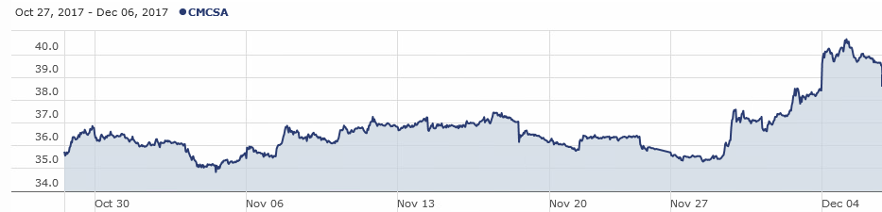
Top Outperformers
Comcast Corporation | CMCSA
Position
330 shares| $11,998.80
Comcast is a global media and technology company headquartered in Philadelphia, Pennsylvania. Their two primary businesses are Comcast Cable and NBCUniversal. Comcast Cable is one of the nation's largest video, high-speed internet and phone providers to residential customers and businesses. NBCUniversal operates news, entertainment, sports cable networks, NBC networks, television production operations, television station groups and Universal Studios.
The stock performed well in the final month of the semester. With net neutrality rules set to be repealed, Comcast and other telecommunications should see a boost.

Slide 71





TOP UNDERPERFORMERS
Lam Research Corp.
Cognizant
Thor Industries
Softbank Group ADR
Stamps.com, Inc.

Slide 72
Top Underperformers
Thor Industries, Inc. | THO
Position
130 Shares | $20,172.02
Thor was one of the last stocks bought for this semester, purchased on November 29th, and over the course of a week returned -4.18%. As a manufacturer of recreational vehicles, Thor saw a decline in stock price along with most other consumer cyclical stocks in this time frame.
As the largest RV manufacturer in the world, Thor just posted its best quarterly revenue and profitability in the company’s history. This past earnings was Thor’s third straight beat in a row, with revenue at an all time quarterly record of $2.28 billion and gross profit at 14.9%. Clearly demand has ramped up, and Thor is matching this demand with increased production.
Despite all of this, we bought in right after all of the good news and only had THO in our portfolio for one week of market declines.

Slide 73
Top Underperformers
Becton Dickinson & Company | BDX
Position
104 Shares | $23,487.36
Becton Dickinson Co. is an American medical technology company. We were only in this stock for the last week of the semester after having purchased it on November 30th. We purchased 104 shares for $225.84.
A major problem for BDX was timing the market. When the stock was pitched it was trading for $220, but the price jumped $6 between the time it was presented and when it was actually purchased.
BDX Declared a $.75 Dividend payable on 12/29 to shareholders of record on 12/8. 2017 is the 46th consecutive year with a Dividend increase.

Slide 74
Top Underperformers
Lam Research Corp. | LRCX
Position
97 Shares | $20,288.37
Lam Research was purchased on November 9th by our class later in the semester, being the first stock in the red-hot semiconductors sector our class invested in. By the end of the semester the stock saw a loss of 13.5%.
Lam is a firm that makes the machines used in the semiconductor manufacturing process. Since the start of 2016 the entire sector has seen massive gains, prompting our class to try and get in on the potential returns.
By the 25th of November, Lam had given us a 3.66% return. During the closing weeks of the semester however, there was a massive sector rotation out of tech stocks and into financials. The semiconductor sector was hit especially hard, as Lam saw a 17% loss in the last two weeks of the semester.

Slide 75
Top Underperformers
Stamps.com, Inc. | STMP
Position
110 Shares | $20,081.22
Stamps.com is an american company that provides internet based mailing and postal service. We bought 110 shares on November 9th.
In an unlucky turn of events, STMP decrease by 5% in the days after we purchased it. Despite exceeding EPS expectations, revenues were about 3.8% lower than expected. STMP is contracted by Amazon and is used to return items purchased on the site. It was in the portfolio for less than a month.

Slide 76
Top Underperformers
Softbank Group ADR | SFTBY
Position
560 Shares | $24,270.40
SoftBank is a Japanese multinational telecommunications company. It is the third largest public company in Japan and is aggressively expanding outside of telecommunications. This was the one and only ADR purchase this semester. Recently, SoftBank made an offer to buy Uber at a discount due to Uber's poor performance over the past year. Due to the diversity in their operations, we were able to classify SoftBank as an IT stock.
SoftBank's was on a steady decline since the portfolio invested on November 29th. SoftBank depreciated around 5% in the short period of time it was in our portfolio.

Slide 77
Student biographies
Fall 2017
Overview
Economic Conditions
Portfolio Strategy & Composition
Sector Summaries
Risk Analysis
Performance Review
Student Biographies

Slide 78


Biographies
Matt is an undergraduate student pursuing a Bachelors of Business Administration with a concentration in Finance and a minor in Mathematics at Loyola University Maryland. In addition to his studies, Matt was Vice President of the Investment Club and a member of Beta Gamma Sigma. After graduation in May 2018, he will likely attend the Hopkins Carey School of Business in pursuit of an MBA.
Matthew Babcock
Nick is an undergraduate student pursuing a Bachelors of Business Administration with a concentration in Finance and a minor in Information Systems at Loyola University Maryland. As a junior, Nick spent a semester in Singapore at Nanyang Technological University, where in addition to his classes, he got to travel the region to experience the culture, and its rich heritage. He has previously interned with Bank of America, as an analyst on their product pricing team in Charlotte, North Carolina. Originally from New Jersey, Nick will be working at Morgan Stanley in Baltimore after graduation.
Nicholas DeProspo

Slide 79


Biographies
Rob is an undergraduate student pursuing a Bachelors of Business Administration with a concentration in Finance and an Information Systems minor at Loyola University Maryland. He is a president of the Loyola Film Society and brother of Alpha Kappa Psi Business Fraternity. Rob has previously interned at the Wealth Advisory Group, NASA and will begin working as a Business Management Analyst at Northrop Grumman in Summer 2018.
Robert DiBias
Bridget is an undergraduate student pursuing a B.B.A. in Finance and a minor in Information Systems at Loyola University Maryland. In addition to her studies, Bridget has held internships with Stanley Black & Decker on the Business Development and Commercial Finance teams and is a member of Loyola's club sailing team and the Financial Management Association National Honor Society. She will be traveling to China in January of 2018 with the Sellinger School in order to study foreign exchange rates. Upon graduating in May of 2018, Bridget will be rejoining Stanley Black & Decker as a member of their Finance Development Program.
Bridget K. Fitzpatrick

Slide 80

Biographies
Kristen is an undergraduate student pursuing a Bachelors of Business Administration with a concentration in Finance from Loyola University Maryland. Previously, Kristen interned at Stifel Nicolaus and Neuberger Berman in the Wealth and Asset Management departments. Along with her studies, Kristen currently interns at T. Rowe Price. Originally from Long Island, New York, Kristen enjoys going to the beach with her family and friends. Kristen has 1,370 more Facebook friends than her fellow fund manager, Sam James.
Kristen Harold
Samuel is an undergraduate student pursuing a Bachelors of Business Administration with a concentration in Finance and a minor in Information Systems from Loyola University Maryland. Sam has interned at Nuveen and is currently an intern at UBS Wealth Management. Sam is known around campus as “the guy from the gym.” Sam has webbed toes.
Samuel James

Slide 81


Biographies
Krysta is pursuing a Bachelors of Business Administration with a double concentration in Finance and Economics at Loyola University Maryland. She is Vice President of the Financial Management Association, a member of the CFA Research Challenge Team, and a member of Alpha Sigma Nu, the Jesuit Honor Society. Last January, she spent two weeks in China studying foreign exchange rates with the Sellinger School. She has spent the last two summers at Republic Bank in Philadelphia as a Commercial Banking Intern and currently interns at McCormick & Company in their Credit & Risk Department. She is looking to further her career in either Philadelphia or New York.
Krysta M. Lipinski
Liam is pursuing a B.B.A. in Finance from the Sellinger School of Business at Loyola University Maryland, graduating in May 2018. Liam serves as President of the Financial Management Association and Beta Gamma Sigma. Additionally, he was a member of the Federal Reserve Challenge Team that won the 2017 Regional Championship. Furthermore, Liam is on the CFA Challenge Team and on Loyola’s Varsity Men’s Crew Team. Liam completed a Sales & Trading internship this summer at the investment firm INTL FCStone, Inc. in New York City and on the weekends worked as a Caddie at Sleepy Hollow Country Club in Westchester County, New York. In his free time, Liam loves to sing, play pick-up soccer with his buddies and appreciates a beautiful sunset. Upon graduation, Liam will be joining Citi’s Middle Market Commercial Banking Team as an Analyst in the Washington D.C. office.
Liam T. Marmo

Slide 82


Biographies
Ray is an undergraduate student pursuing a Bachelors of Business Administration with a concentration in Finance at Loyola University Maryland. Ray is from Brooklyn, New York and has spent the past two summers and winters working as a tax intern with Starr Companies in New York City. Upon graduating, Ray intends to continue his education and earn his MBA while working alongside the start-up, Save Pharmaceutical, where he intends to fulfill the role of Chief Financial Officer.
Raymond McEvoy
Andrew is an undergraduate student pursuing a Bachelors of Business Administration with a concentration in Finance at Loyola University Maryland. He is a member of the Sellinger Scholars, Beta Gamma Sigma, and the Financial Management Association Honor Society. Andrew previously interned with Israel A. Englander & Co. on the Options Trading floor of the NYSE and at the U.S. House of Representatives as a Financial Services intern. Upon graduation, he hopes to further his career in finance in either the New York or Boston area.
Andrew Muscarella

Slide 83


Biographies
Frank is a Finance/Accounting Double major and President of Loyola’s Fixed Income Society. He interned at Metropolitan Commercial Bank in Summer 2017. During the fall semester, he did equity research for Blue Point Investment Management until switching to a Planner Assistant role at Maller Wealth Advisors. Upon Graduation, he will work as an Assurace Associate at PriceWaterhouseCoopers Baltimore office, specializing in Financial Service companies.
Frank Musuruca
Delia is an undergraduate student pursuing a Bachelors of Business Administration with a concentration in Finance at Loyola University Maryland. She is a member of the Financial Management Association Honor Society. Delia previously interned with Legg Mason on the Global Sales Analytics team. She plans to further her career in Asset Management following graduation in May 2018.
Delia Oldak

Slide 84


Biographies
Nicole is an undergraduate student pursuing a Bachelors of Business Administration with a double concentration in Finance and Economics at Loyola University Maryland. In addition to her studies, Nicole holds a leadership position at Loyola’s Phonathon and is a member of the Beta Gamma Sigma Honor Society. She previously interned with Nielsen and Cigna near her home in Connecticut. Upon graduation, Nicole will remain in Baltimore where she will begin her career at Morgan Stanley.
Nicole Postighone
Zach is an undergraduate student pursuing a Bachelors of Business Administration with a concentration in Finance and a minor in Economics at Loyola University Maryland. Aside from being a student, Zach is a member of Loyola’s Sellinger Scholars Program, the Financial Management Association, volunteers for the York Road Micro-Finance student consulting team, and is the founder of Greyhound Consulting Group on campus. He has previously held internships with Aetna inc., CFG Capital Markets, and Under Armour. In his free time, he enjoys playing golf with his family and friends. Following graduation, Zach will be working for EY in the Chicago office as a member of the Business Advisory Program.
Zachary Russo

Slide 85


Biographies
Alex is an undergraduate student pursuing a Bachelors of Business Administration with a concentration in Finance. He is a member of the Men’s Cross Country team, Investment Club and Financial Management Association. Alex has previously interned at Tata Global Beverages and he will be pursuing a career in Commodities trading.
Alexander Saffadi
Vinny is an undergraduate student pursuing a Bachelors of Business Administration with a concentration in Finance and Accounting. He is a member of Beta Alpha Psi and was the Vice President of Loyola Rugby. He interned at PricewaterhouseCoopers in Baltimore and will begin full time in the Fall of 2018.
Vincent Sireci

Slide 86


Biographies
Dan is an undergraduate student pursuing a Bachelors of Business Administration with a concentration in Finance at Loyola University Maryland. He is an international student who is a co-president of the Loyola Investment Banking Club. In addition, he has interned for the International Labor Organization, AXA Advisors, foreign banks, and various charitable organizations. He is currently seeking employment upon graduation and enjoys spending his time with friends, reading, and going to the movies.
Dan Tun
Elizabeth is an undergraduate student pursuing a Bachelors of Business Administration with a concentration in Finance. In addition to her studies, she is a member of the Division I swimming & diving team at Loyola as well as the Financial Management Association and Student Philanthropy Council. Elizabeth has previously spent two summers as an intern with Philadelphia Insurance Companies at their headquarters near Philadelphia. Following graduation, Elizabeth will be beginning her career at Vanguard within the Fund Financial Services department. Her lifelong dream is to be on the Amazing Race but is still looking for the perfect partner.
Elizabeth Verzella

Slide 87


Biographies
Brian is an undergraduate student pursuing a Bachelors of Business Administration with a concentration in Finance and a minor in information systems. He is the captain of the rugby club, member of the financial management association, and part of Loyola’s CFA Challenge team. He interned at Morgan Stanley throughout the summer and fall, where he will begin full time after graduating.
Brian Wright
Josh is an undergraduate student pursuing a Bachelors of Business Administration with a double concentration in Finance and Marketing at Loyola University Maryland. Josh has previously interned with Sony, Fallston Group LLC, CBS, Obsidian Financial Services, and T Rowe Price. Aside from his studies, Josh is involved with Loyola’s Financial Management Association and plans on pursuing a Master of Finance degree after graduation.
Joshua A. Zingaro

Slide 88






